Slide 1
Unit 3
Lecture 2

Slide 2
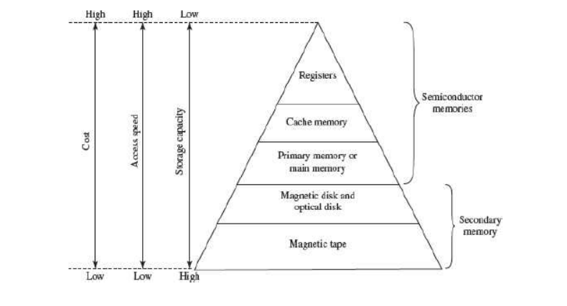
Memory Hierarchy :
The memory hierarchy separates computer storage into a hierarchy based on response time.

Slide 3
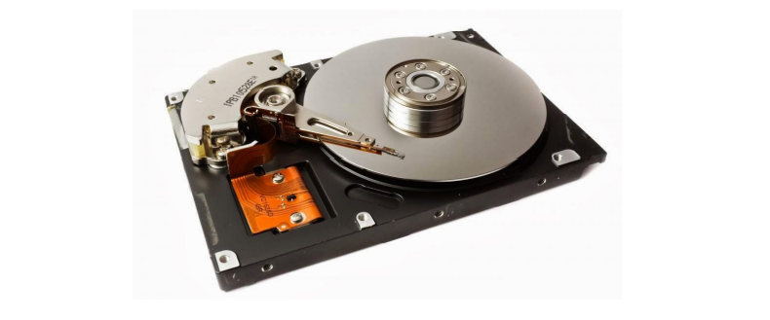
Magnetic Disk:
• A magnetic disk is a storage device that uses a magnetization process to write, rewrite and access data.
It is covered with a magnetic coating and stores data in the form of tracks and sectors.
Hard disks and floppy disks are common examples of magnetic disks. With the development of solid state drives (SSDs), magnetic disks are no longer considered the only option, but are still commonly used

Slide 4
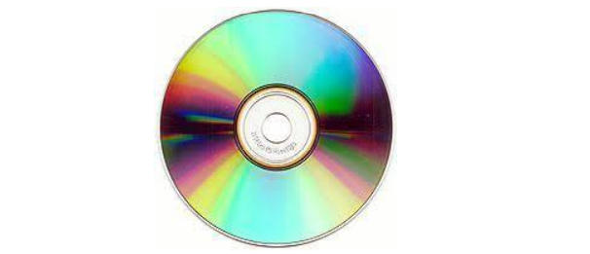
Optical Disk:
• An optical disk is any computer disk that uses optical storage techniques and technology to read and write data.
• It is a computer storage disk that stores data digitally and uses laser beams (transmitted from a laser head mounted on an optical disk drive) to read and write data.
• An optical disk is primarily used as a portable and secondary storage device.
• Compact disks (CD), digital versatile/video disks (DVD) and Blu-ray disks are currently the most commonly used forms of optical disks.

Slide 5
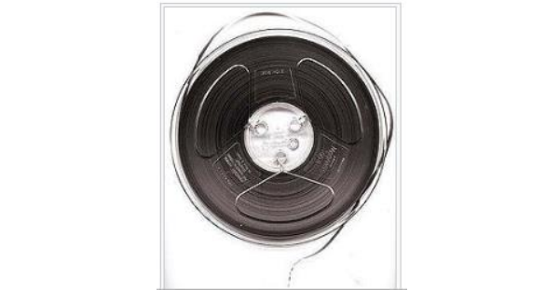
Magnetic Tape:
• Magnetic tape is a medium for magnetic recording, made of a thin, magnetizable coating on a long, narrow strip of plastic film.

Slide 6
Blu Ray Discs
Is an optical disc designed for high definition video and store large amount of data.
It is a successor to DVD.
It makes use of shorter wavelengths of blue light to read or write even smaller pits on the optical disc.
The format’s name comes from the fact that a blue laser reads from and writes to the disc rather than the red laser of DVD players.
A single layer Blu ray disc can hold a 135 minute high definition movie and still have room for two hours .
Two layer disc stores 50 GB

Slide 7
Interconnecting the Units of a Computer:
CPU sends data, instructions and information to the components inside the computer as well as to the peripherals and devices attached to it.
The different components of computer are connected with each other by a bus.
The data, instructions and the signals are carried between the different components via a bus.
• A bus is a set of wires used for interconnection, where each wire can carry one bit of data.
• A bus width is defined by the number of wires in the bus.

Slide 8
Buses
• A bus is a high-speed internal connection. Buses are used to send control signals and data between the processor and other components.
• Three types of bus are used –
• Address bus - carries memory addresses from the processor to other components such as primary storage and input/output devices. The address bus is unidirectional.
• Data bus - carries the data between the processor and other components. The data bus is bidirectional.
• Control bus - carries control signals from the processor to other components. The control bus also carries the clock's pulses. The control bus is unidirectional

Slide 9
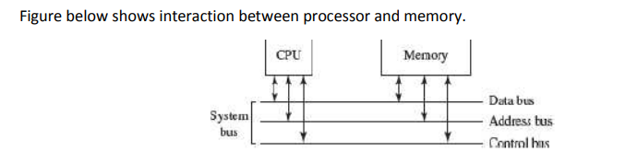
The External Bus connects the different external devices, peripherals, expansion slots, I/O ports and drive connections to the rest of computer.
The external bus allows various devices to be attached to the computer. It allows for the expansion of computer’s capabilities.
It is generally slower than the system bus. It is also referred to as the Expansion Bus.

Slide 10
The interaction of CPU with memory and I/O devices involves all the three buses.
❖ The command to access the memory or the I/O device is carried by the control bus.
❖ The address of I/O device or memory is carried by the address bus. ❖ The data to be transferred is carried by the data bus

Slide 11
Memory Representation:
• The computer memory stores different kinds of data like input data, output data, intermediate results, etc., and the instructions. Binary digit or bit is the basic unit of memory.
• A bit is a single binary digit, i.e., 0 or 1. A bit is the smallest unit of representation of data in a computer. However, the data is handled by the computer as a combination of bits. A group of 8 bits form a byte.
• One byte is the smallest unit of data that is handled by the computer. One byte can store 2^8, i.e., 256 different combinations of bits, and thus can be used to represent 256 different symbols.
• In a byte, the different combinations of bits fall in the range 00000000 to 11111111.
• A group of bytes can be further combined to form a word. A word can be a group of 2, 4 or 8 bytes.

Slide 12
1 bit=0 or 1
1 Byte (B)= 8 bits
1Kilobyte (KB)= 2^10 =1024 Bytes
1Megabyte (MB) =2^20=1024 KB
1 Gigabyte (GB) = 2^30 = 1024 MB
1 Terabyte (TB) =2^40 =1024 GB

Slide 13
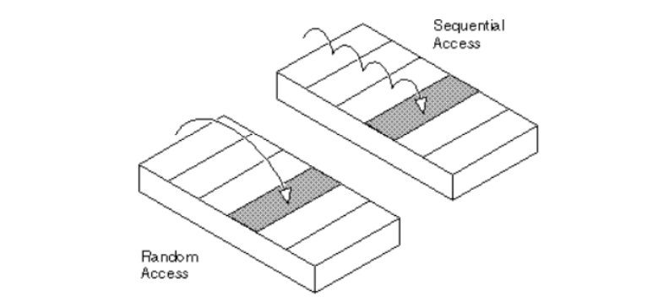
Access types of storage devices:
Access type of any storage device depends on how data can be read and written into it. Generally, the information stored in storage devices can be accessed in two ways: Sequential Access and Random Access (Direct Access)

Slide 14
Sequential Access Devices:
• Sequential access means that computer must run through the data in sequence, starting from the beginning, in order to locate a particular piece of data.
• Magnetic tape is an example of sequential access device.
• Let us suppose that magnetic tape consists of 80 records.
To access the 25th record, the computer starts from first record, then reaches second, third etc. until it reaches the 25th record. Sequential access devices are generally slow devices.

Slide 15
Advantages of sequential access
It is simple to program and easy to design.
Sequential file is best use if storage space.
Disadvantages of sequential access
• It is time consuming process.
• It has high data redundancy.
• Random searching is not possible

Slide 16
Direct Access Devices:
• Direct access devices are the ones in which any piece of data can be retrieved in a non-sequential manner by locating it using the data’s address.
It accesses the data directly, from a desired location.
• Magnetic disks and optical disks are examples of direct access devices. There is no predefined order in which one can read and write data from a direct access device.
• In a magnetic disk consisting of 80 records, to access the 25th record, the computer can directly access the 25th record, without going past the first 24 records.
• Based on access, magnetic tapes are sequential access devices, and, magnetic disks, optical disk and magneto-optical disks are direct access devices.

Slide 17
Advantages/Pros of direct access
Direct access file helps in online transaction processing system (OLTP) like online railway reservation system.
• In direct access file, sorting of the records are not required.
• It accesses the desired records immediately.
• It has better control over record allocation.
Disadvantages/Cons. of direct access
Direct access file does not provide back up facility.
• It is expensive.
• It has less storage space as compared to sequential file.

